Slide 1
Internship Presentation
Multiple Topics in MobiKa

Slide 2
Agenda
Introduction
Results
Recommendations

Slide 3
Introductions

Slide 4

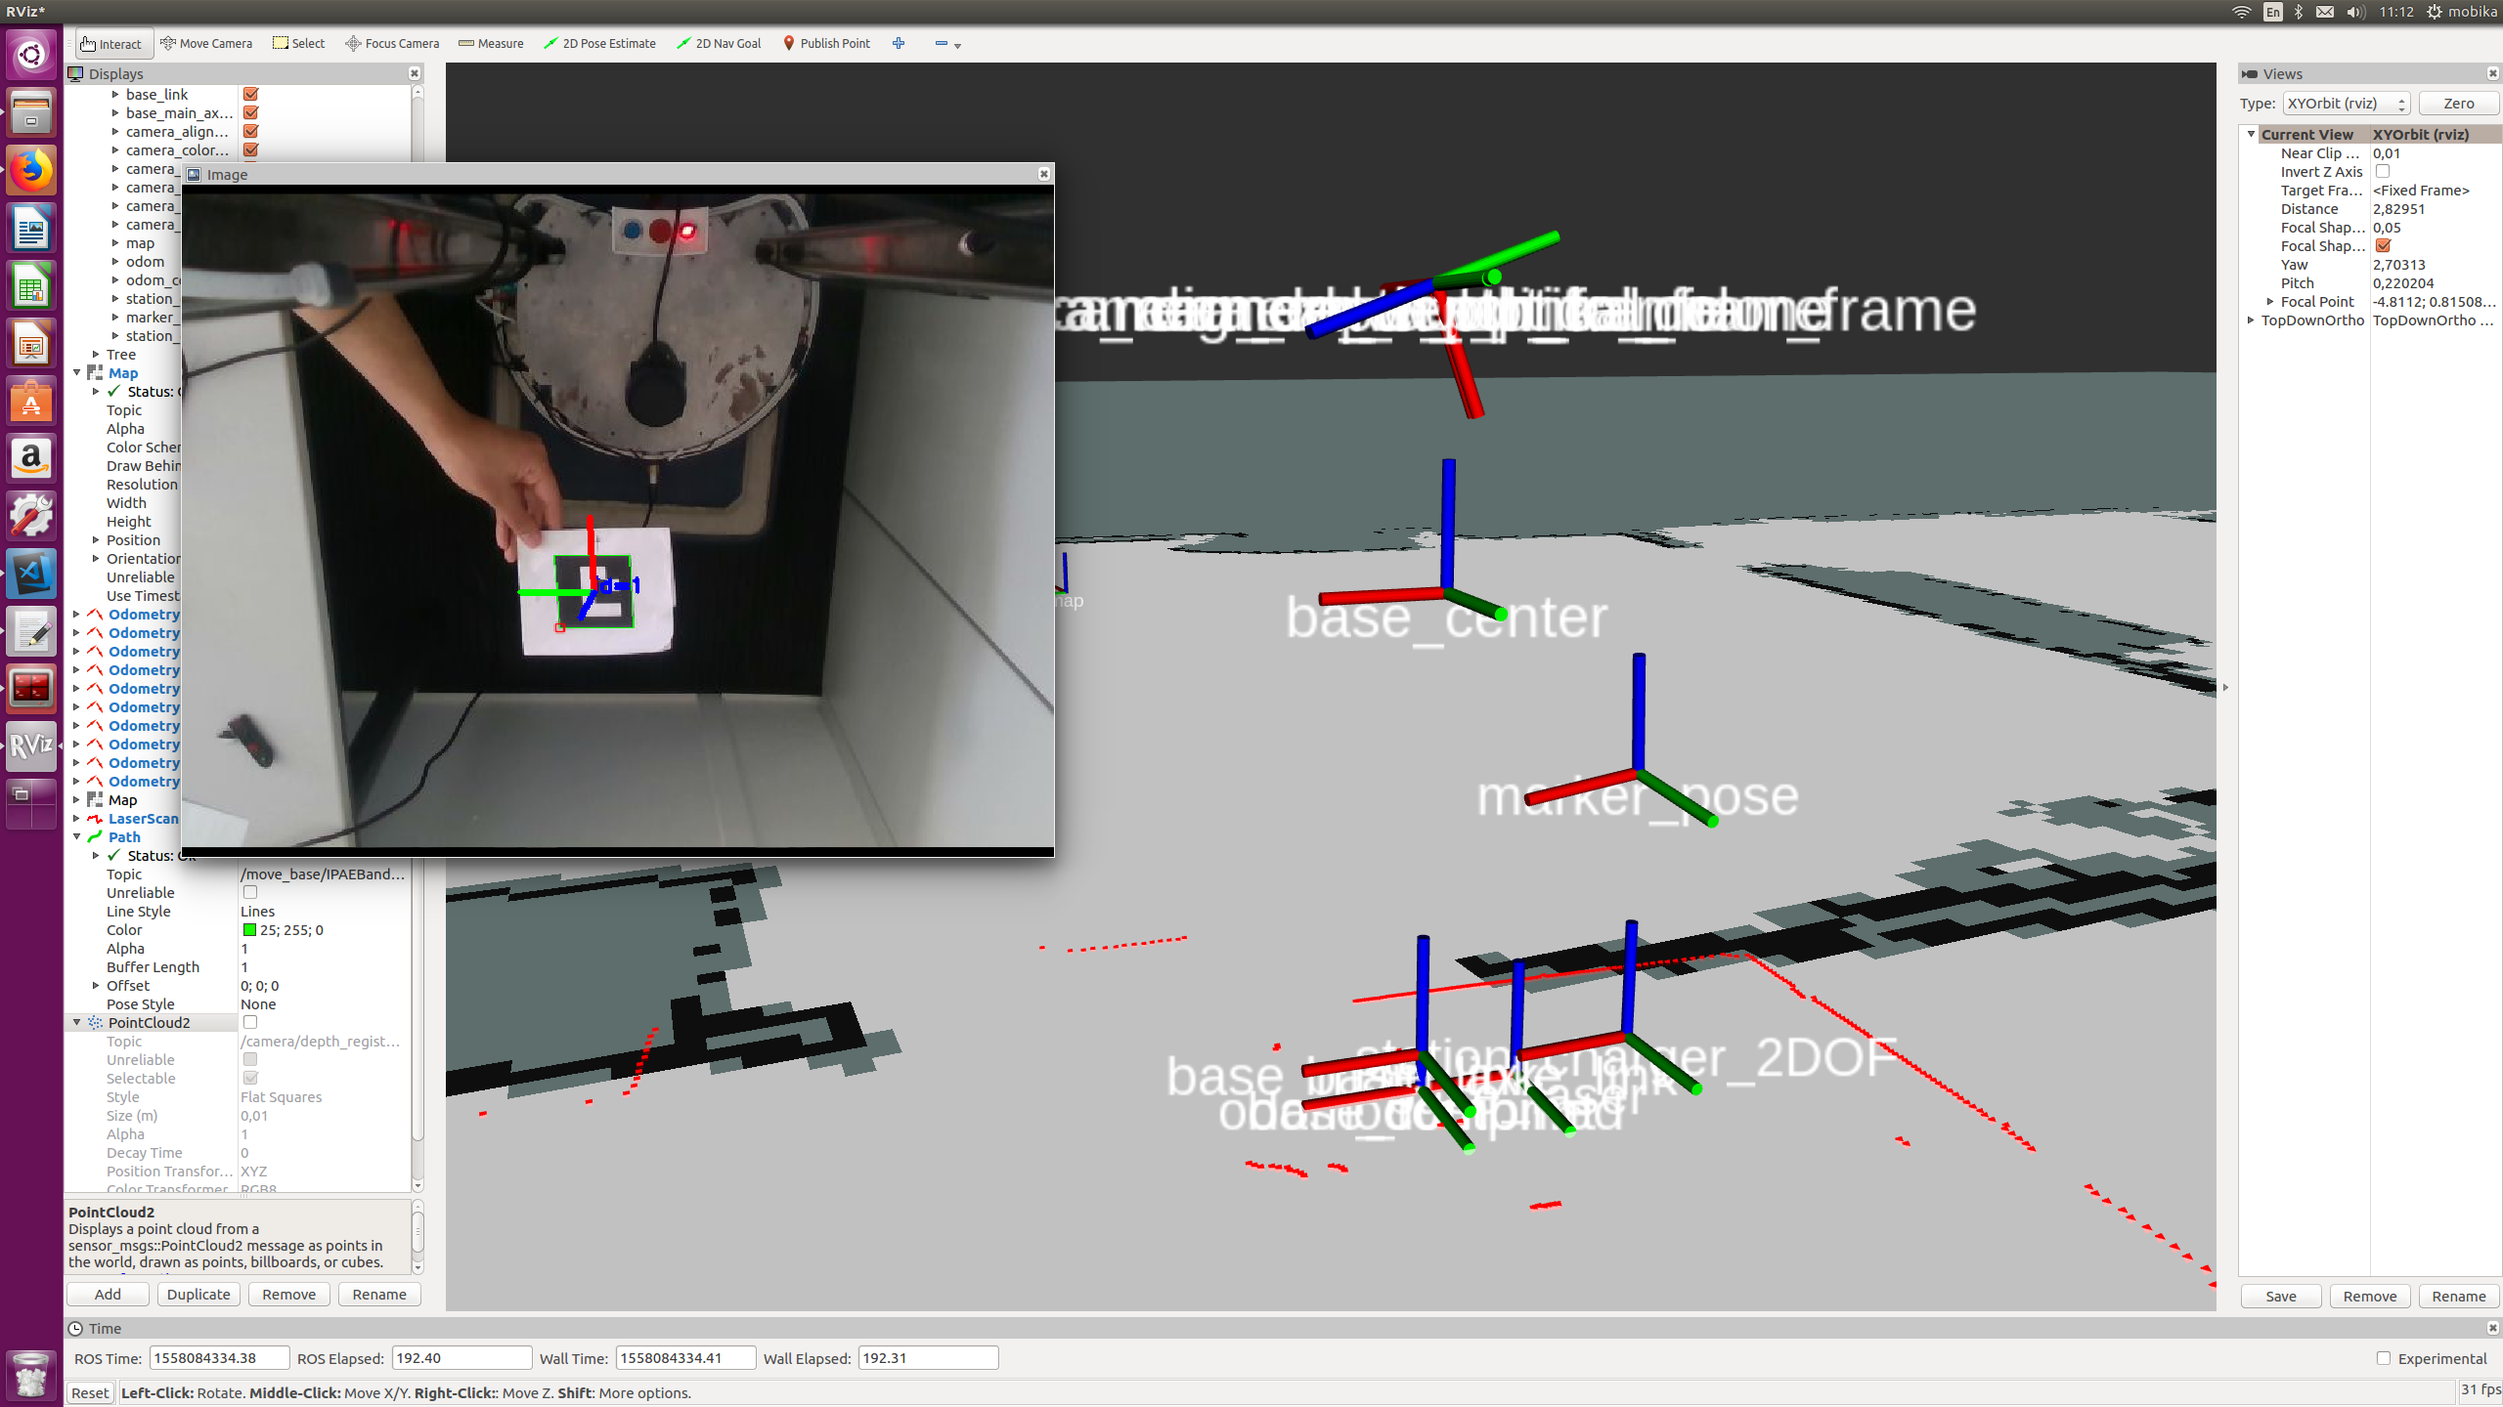
Marker Detection and Pose Estimation
Standard Aruco Marker Library http://wiki.ros.org/aruco_detect to detect the marker
Subscribe to topic /fiducial_transforms (marker pose)
Publishing a TF between camera and the Marker
6DOF marker pose
Transform the 6DOF marker pose to 2DOF marker pose
How? Listen TF between 6DOF marker_pose to base_link and take only value of x, y and yaw
2DOF marker pose
Notes:
Using the standard Library of Aruco Marker, which is available in the internet and already in ROS platform. And also implemented it with realsense camera, so I used the realsense wrapper for ROS.
So then I make from scratch a simple TF publisher code, which subscribe to a topic of fiducial transforms from the aruco detect code which consist of the position and also the orientation in 6DOF space. With that information then I publish the TF based on that information between the marker and also the camera
But then the requirement is not in 6DOF, the requirement is in 2DOF space, so then I need to transform the pose. And to do that, I listen to the TF between the marker pose and the base_link. And then take the value of x , y and yaw from that information. And make the z equals to 0 and also the roll and pitch.

Slide 5
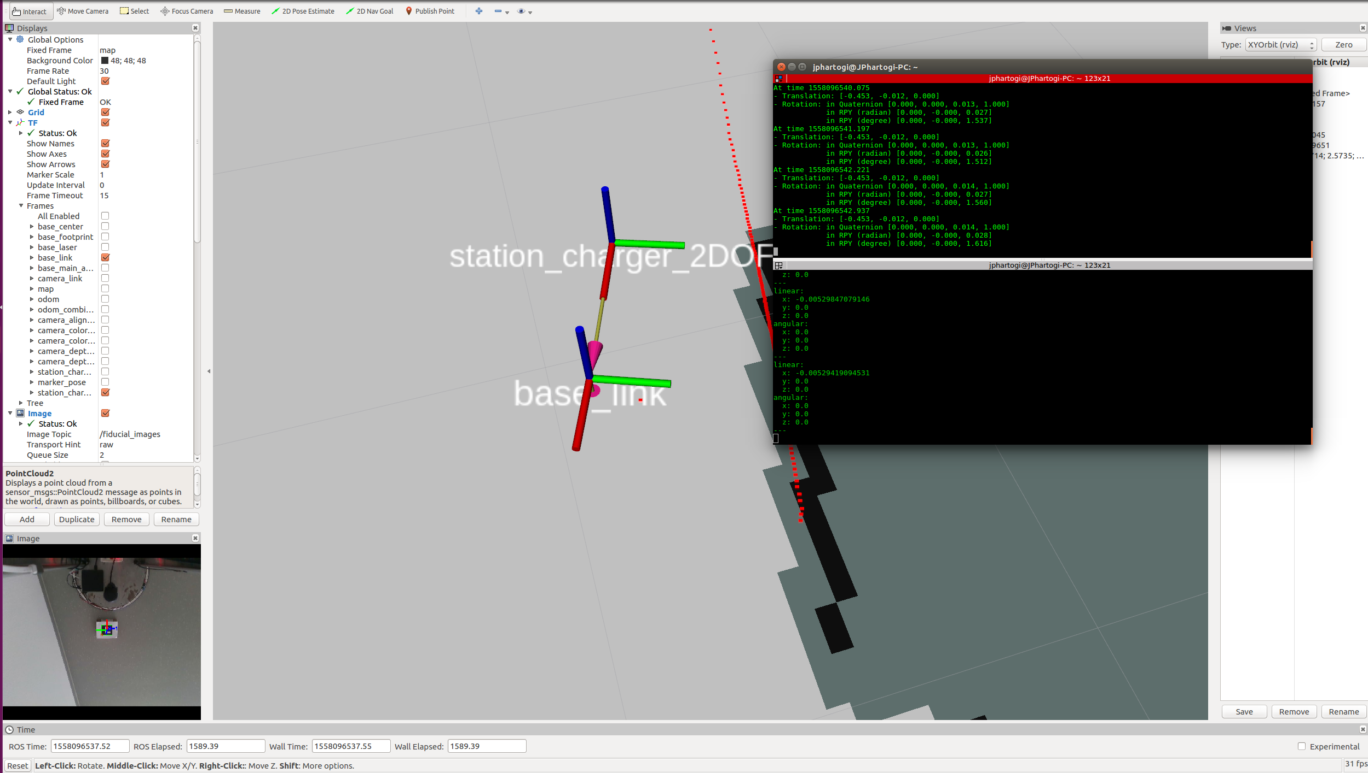
Docking Stations
Implementing and modified the IPA differential docking ( from forward docking to backward docking ) code
Test and implement docking the robot to the transformed detected marker
Notes:
There is already an existing docking code, ipa differential docking and cob docking. It is listening to a TF for the docking process. And then this code combine with the previous code to dock the robot. But then I need to modified a little bit, because the previous code docks in forward direction. But the requirement for mobika is to dock in backward direction for charging.
Then I combine this two code together, and I have tested and try to implemented it. First I tried the differential docking code in simulation to see if it’s working, and then implemented it in the mobika robot. And then I have couple videos of the result of the docking.

Slide 6
Result Video
Notes:
- Here are two videos of the result of the docking process.

Slide 7
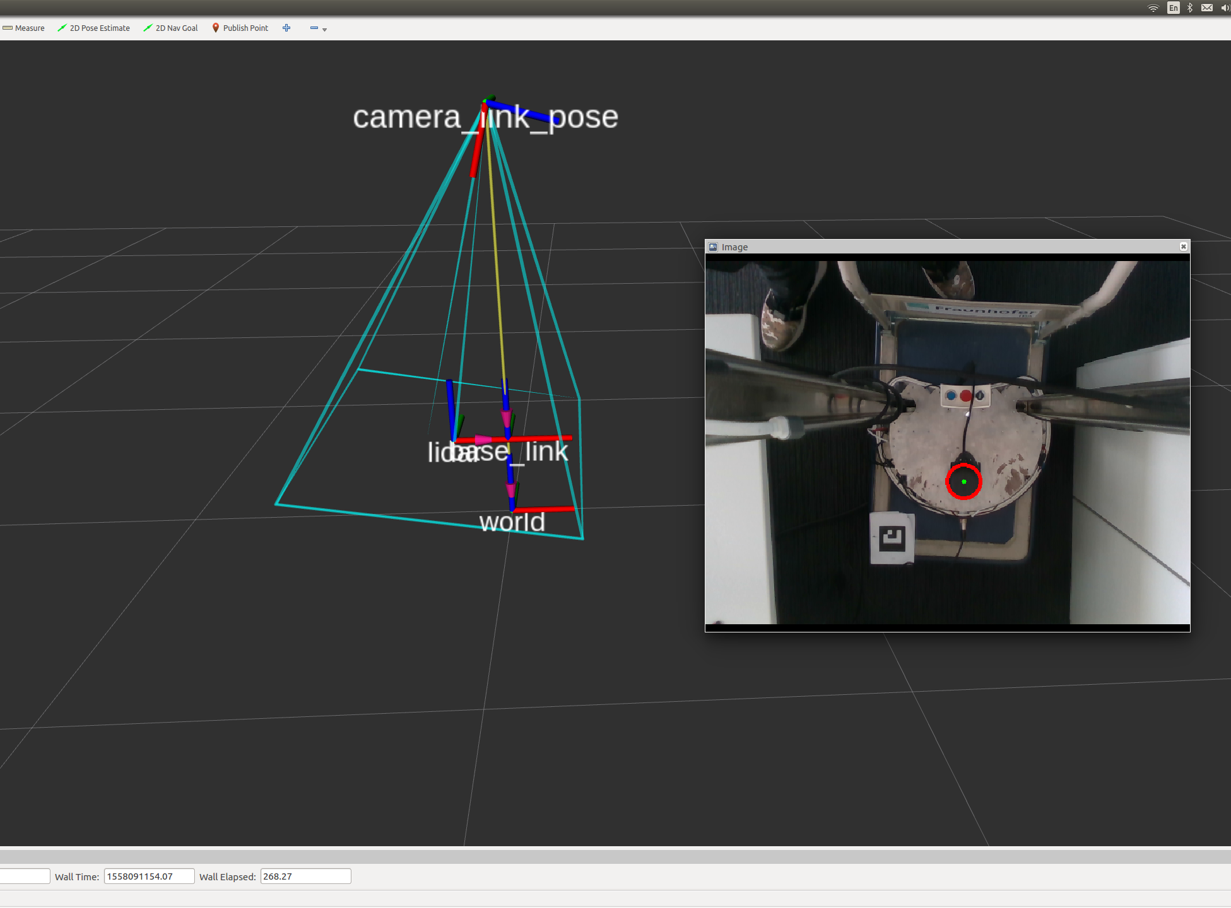
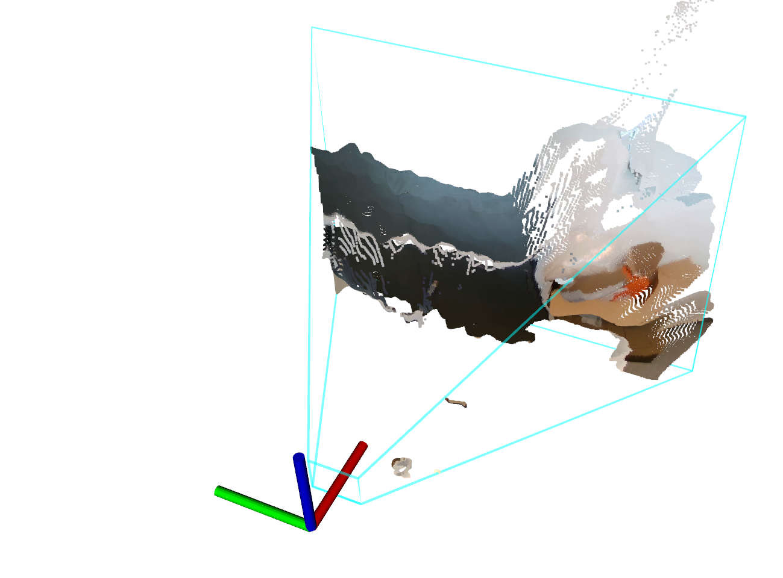
Camera pose estimation
Using the static feature in the robot ( Lidar ) to detect the pose of the camera
Using the Hough circle transformation https://docs.opencv.org/2.4/doc/tutorials/imgproc/imgtrans/hough_circle/hough_circle.html
Publish the TF of the camera pose
Create 2 mode, debugging and not debugging mode.
Debugging mode is always calculating the pose
Not-debugging mode take 10 data and get the median of the data as final data.
Notes:
Here is the camera pose estimation, which use the feature in the robot, which is static. In this case the Lidar. While it is in circular shape, we can take advantage of Hough circle transformation to detect the Lidar.
So in this project I use the hough circle transformation, which is a standard library in opencv and use it to detect the circular shape of the Lidar.
And I am also using the camera FOV in this project as one of the tools to get the angle of the camera. And it will be later explained in the next slide.
Then I publish the TF of the camera pose, which use the angle detected from the previous process
I also create two mode for this project, which is the debugging mode, and non-debugging mode. The debugging mode is always calculating the pose or angle in a infinite loop, while the non debugging mode take 10 data and take the median as the final data, while it probably occurs some false position of the circle.

Slide 8
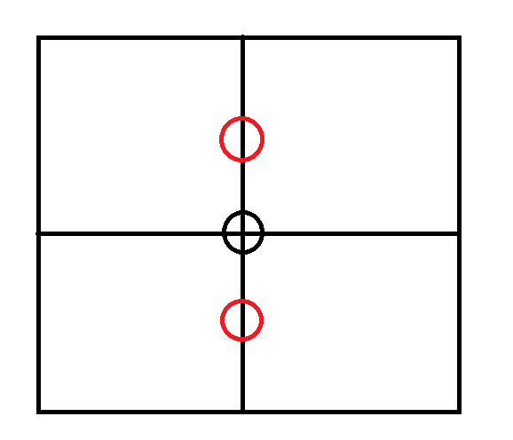
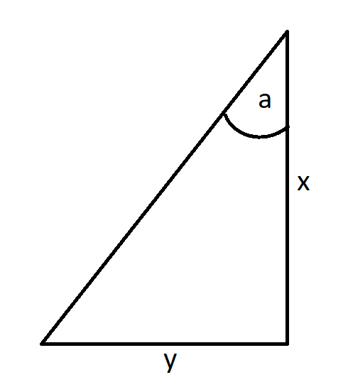

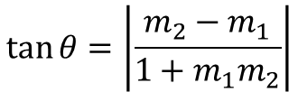



Camera Pose Initialization and Estimation
tan θ = m2−m11+m1m2
$$θ=a−b$$
$$camera angle=\left\{\begin{aligned}\text{a}−θ, y<y_{ref} \\ &\text{a}+θ, y≥y_{ref}\end{aligned}\right.$$
$$\tan{θ=\left|\frac{m_{2}−m_{1}}{{1+m}_{1}m_{2}}\right|}$$
Where $m_{2}$ = Reference gradient (const), and
$m_{1}$ = Detected circle gradient
Camera frame
Camera_link
Detected circle
a (ref angle) = $\tan^{−1}{\frac{y_{ref}}{x_{ref}}}$
reference
y
b
Lidar
x
Base_link
Notes:
Remember!
The reference colored in black, and when it is at the middle of the camera frame, the camera is at the angle which is straight / looks directly to the Lidar. So I used that as the reference frame.
What I want search or obtained is the b , but I calculated first the difference of the angle, which is theta. And then it can be easily obtained by this equation. And gradient equation is simply straight forward, which is the delta y divided by delta x.
- It calculated in 2D because the movement of the camera is restricted in one direction only. So the detected circle will always be in one line.

Slide 9
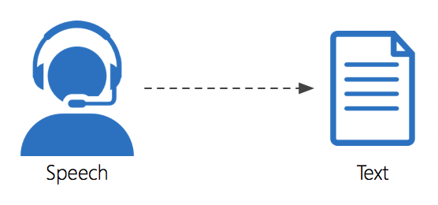
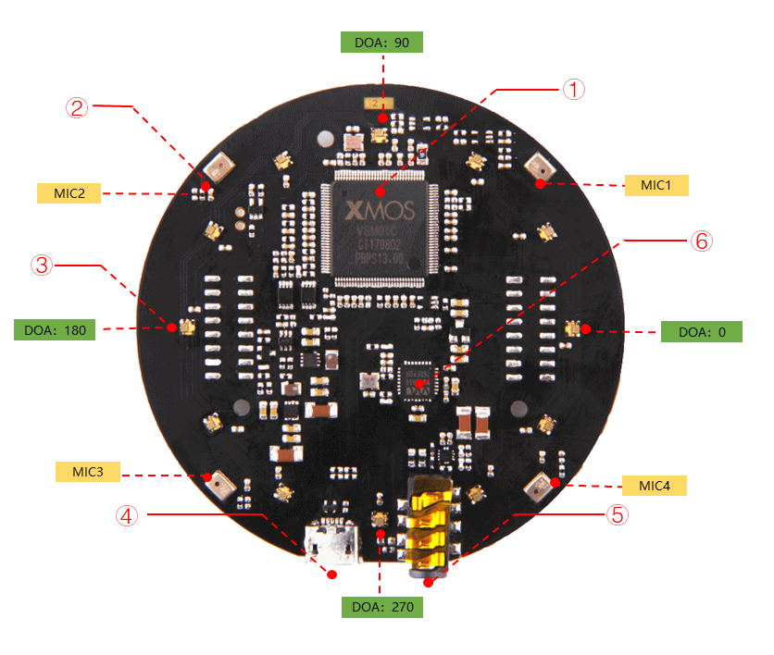
Speech Recognition
Using the online and offline (google and sphinx ) speech recognition and text to speech API
Extracting the speech into data type string, there is lot of possibility to do with the data
Example :
Extract some keywords , ( “ come “, or “ closer “ )
Decision making with yes or no question

Slide 10
Demo Speech Recognition
Robot “ Come Here “ Command
Testing speech recognition conversation

Slide 11
Tablet Height Control
Using Roboclaw motor and encoder to control the motor
Can be called with a service, the service consist of the desired height (in cm)
Controlled automatically but also can be controlled with joystick
Add acceleration and deceleration for the tablet speed
Notes:
Use the roboclaw motor and encoder to control the motor. It can called by a service which, as specific type of service that commands a desired height in cm.
I also make it can be go automatically to the target height, but also can be controlled manually by joystick. If automatic, the first step it needs to initialize first to the very bottom of the height, then it can go up.
And I also added some acceleration and deceleration mode for the tablet which will be explained in the next slide.

Slide 12
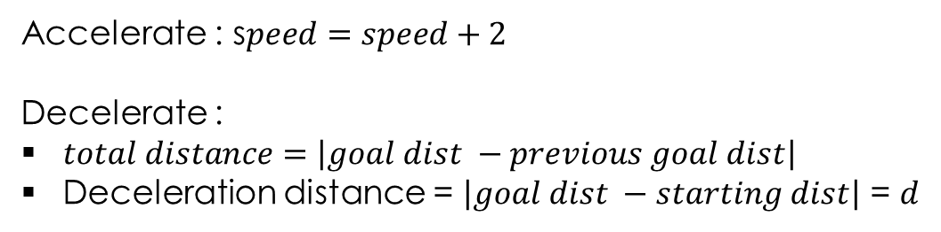


Acceleration and decceleration
Accelerate : s$peed=speed+2$
Decelerate :
$total distance=\left|goal dist −previous goal dist\right|$
Deceleration distance = $\left|goal dist −starting dist\right|$ = $d$
Constant speed
s$peed=\left(\frac{\max{speed −\min{speed}}}{d} ∗\left|goal_{dist}−curr_{dist}\right|\right)+\min{speed }$
accelerate
decelerate
Current speed
$v ( \frac{m}{s} )$
$$x \left( m \right)$$
Starting_dist
Goal_dist
Notes:
So this is the diagram of the how the speed of the tablet when go up or down.
For acceleration is very straight forward, only use the increment function, as speed = speed + 2 and after maximum speed, it will change into constant speed
For the deceleration, first we need to calculate the total distance that will be traveled. And when to decelerate is actually can be change easily, but in here I am using, for safety reason, while if the goal distance is bigger, then when to decelerate is also bigger so it is more safety.

Slide 13
Recommendations
Speech recognition is able to take people speech into string, and can be used for commands, decision and to have a simple conversation.
Docking still need to be optimized in terms of speed, precision, fixed when the marker is no longer detected by the camera to publish a last known TF in orientation to map.
Tablet height control needs to fixed especially in the initialization part, to make sure the switch is pressed firmly

